Slide 1
Principal Sessoms Report
Dunbar Elementary
GO Team Meeting #2
10/20/22
Where we are – Where we’re going

Slide 2
Where We Are
Our strategic plan is the guide for the work we’re doing in the school. By monitoring the plan and ranking priorities, we can all work towards the common goals. Using the priorities in the strategic plan, the school leadership team developed a Continuous Improvement Plan (CIP) for the current school year.

Slide 3
Timeline for GO Teams
You are HERE
Fall 2021
GO Team Developed 2021-2025 Strategic Plan
1
Summer 2022
School Leadership completed Needs Assessment and defined overarching needs for SY22-23
2
August 2022
School Leadership completed 2022-2023 Continuous Improvement Plan
3
Sept. – Dec. 2022
Utilizing current data, the GO Team will review & possibly update the school strategic priorities and plan
4
Before Winter Break
GO Team will take action (vote) on the rank of the strategic plan priorities for SY23-24 in preparation for budget discussions.
5

Slide 4
Discussion Items
Current Strategic Plan
Continuous Improvement Plan
Needs Assessment
SMART GOALS
Monitoring Measures
MAP Data
Data Protocol

Slide 5
Current Strategic Plan
2021-2025

Slide 6
Mission-Paul Laurence Dunbar Elementary is a school that nurtures and develops life- long learners who are problem solvers and internationally minded citizens.
Paul L. Dunbar Elementary
Vision-Paul Laurence Dunbar is a school where excellence is expected and all students are developed academically, socially, and emotionally in order to become globally competitive.
SMART Goals
Increase the % of grades 3-5 students scoring proficient or above in reading from 17% Spring GMAS 2019 to 20% on Spring GMAS 2022
Increase the % of grades 3-5 students scoring proficient or above in math from 15% on Spring GMAS 2019 to 18% on Spring GMAS 2022
Reduce the number of insubordinate behavior referrals by 10% from 2019 to 2021-2022 SY
Increase parent participation in school hosted events
APS Strategic Priorities & Initiatives
School Strategic Priorities
School Strategies
Fostering Academic Excellence for All
Data
Curriculum & Instruction
Signature Program
1. Weekly Data Review PLCS
2. International Baccalaureate school-wide implementation
3. Focus on Literacy and Math instructional best practices
1A. Review of NWEA/MAP, HMH, Attendance, and Behavior Data weekly
1B. Quarterly Parent Teacher Data Conferences
1C. Learning Walks for Intervention, Guided Reading, IB, and Math
Building a Culture of Student Support
Whole Child & Intervention
Personalized Learning
Intervention Block with HMH
After School Tutorial
BASC-3 Behavior Screener
Weekly CARE Team Meetings
2A. Care Team weekly meetings and student tracker
2B. Pre and Post Data for students attending after school tutorial
2C. Full-time Wrap-Around Supports (Counselor, Behavior Specialist, MTSS, Social Worker)
Equipping & Empowering Leaders & Staff
Strategic Staff Support
Equitable Resource Allocation
8. Grade Level Leaders
9. Leadership Development Opportunities (Coordinators;Club Sponsors)
10. ESOL,SPED, & Homeless Inclusion
3A. PLC Norms and Protocols
3B. After School Coordinator Leadership Opportunities and Planning Meetings
3C. Allocation of General Budget and other funding sources for ESOL, SPED, & Poverty Students
Creating a System of School Support
Collective Action, Engagement & Empowerment
4A. Monthly School Newsletters
4B. Monday Folder communication of flyers and announcements
4C. Social Media Blasts
4D. Robo Calls and Class Dojo
11. Community Partners Network
12. On-Campus AVLF resources
13. Parent Liaison and Parent Center
14. Community CARE Closet
15. Sheltering Arms Educare Center

Slide 7
Continuous Improvement Plan
SY 2022-2023

Slide 8
School Name: Paul L. Dunbar ES
Needs Assessment
Strengths | Opportunities/Challenges
Students demonstrated better performance on GMAS on narrative writing. | Increase the number of students that are proficient in ELA
Students performed better in ELA on GMAS than other content areas. | Increase the number of students that are proficient in Math
47% of Students at Dunbar Exceeded Growth Targets Fall to Spring for MAP ELA | Increase the number of students that are proficient in Science
 | Decrease the number of out of school suspensions based on the 2021-2022
Our Overarching Needs
Literacy: To increase the number of students that are proficient in ELA | Numeracy: To increase the number of students that are proficient in Math | Whole Child & Student Support: To decrease the number of out of school suspensions based on the 2021-2022 school year
Jamboard Link
Literacy Problem Statement | Numeracy Problem Statement | Whole Child & Student Support Problem Statement
Over 50% of students did not score proficient in Reading based on GMAS and NWEA/MAP. | Over 50% of students did not score proficient in math based on GMAS and NWEA/MAP. | Dunbar staff need culturally responsive engagement strategies to address the needs of Dunbar students.
Notes:
Notes for School CIP Teams: After completing your Comprehensive Needs Assessment ( data protocol), you will come here and identify some strengths and opportunities/challenges you have observed from the data. The priority areas are Literacy, Numeracy, and Whole Child & Student Support. Identify an overarching need for each area. Formulate a problem statement for each area. Make sure the problem statement meets the criteria. Refer to your CIP resources.

Slide 9
Paul L. Dunbar Elementary
School Name
Goals
Our Overarching Needs
LITERACY (ES: Literacy Proficiency) To increase the number of students that are proficient in ELA | NUMERACY (ES: Numeracy Proficiency) To increase the number of students that are proficient in Math | WHOLE CIHILD & STUDENT SUPPORT (Whole Child/Student Support) To decrease the number of incidences of fighting as compared to the 2021-2022 school year.
SMART Goals (Elementary/Middle School)
Increase the % of grades 3-5 students scoring proficient or above in reading from 13% Spring GMAS 2022 to 18% on Spring GMAS 2023 (5% Growth) | Increase the % of grades 3-5 students scoring proficient or above in math from 7% Spring GMAS 2022 to 12% on Spring GMAS 2023 (5% Growth) | Reduce the number of fighting incidences by 2%
SMART Goals (High School)
Progress Monitoring Measures
●Georgia Milestones ●NWEA/MAP Universal Screener (K-5) ●iRead (K-2) ●System 44/Read 180 (K-5) ●Write Score assessment Data (3-5) | ●Georgia Milestones ●NWEA/MAP Universal Screener (K-5) ●Study Island Math | ●Behavioral Referrals (APS Graphs & IC) ●Universal Behavioral Screener (BASC-3) ●Family Ties Referrals
Notes:
Notes for School CIP Teams: On this slide you will identify SMART goals for each priority area and how you will monitor progress towards those goals

Slide 10
Our Current Progress Monitoring Measures
Literacy
Numeracy
Whole Child
●Georgia Milestones
●NWEA/MAP Universal Screener (K-5)
●iRead (K-2)
●System 44/Read 180 (K-5)
●Write Score assessment Data (3-5)
●Georgia Milestones
●NWEA/MAP Universal Screener (K-5)
●Exact Path-Edmentum Math
●Behavioral Referrals (APS Graphs & IC)
●Universal Behavioral Screener (BASC-3)
●Family Ties Referrals

Slide 11
NWEA/MAP Data
Fall Administration

Slide 12
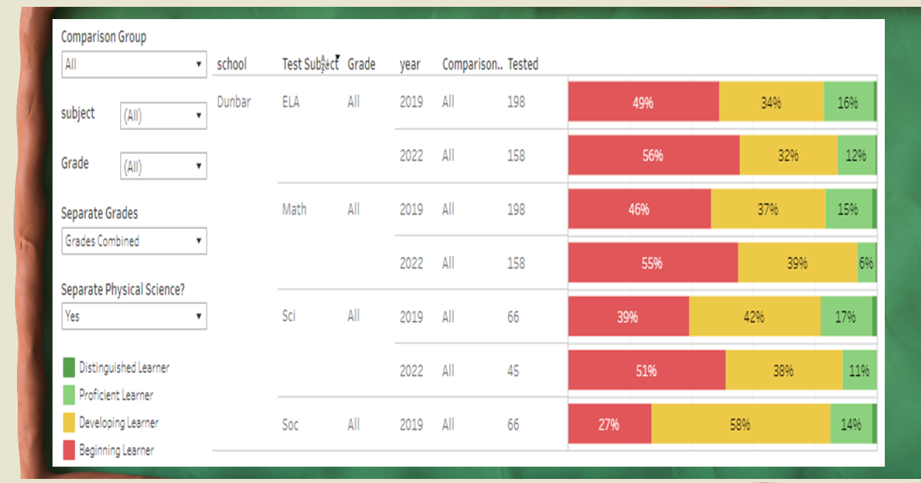
GMAS 2019 & 2022 Results

Slide 13
GMAS Results

Slide 14
GMAS Results

Slide 15
GO Team Discussion: Data Protocol
What do you notice?
What are your wonderings?
What additional questions do you have?

Slide 16
Strategic planning will help you fully uncover your available options, set priorities for them, and define the methods to achieve them.
Robert J. Mckain

Slide 17
Where we’re going
At our next meeting(s) we will discuss how our data is aligning to our strategic plan and determine if we need to make any adjustments.
Before the end of Fall Semester, we will take Action (vote) on ranking our strategic priorities for the 2023-2024 school year.
Let me or the Chair know of any additional information you need for our future discussion.

Slide 18
Thank you

